Slide 1



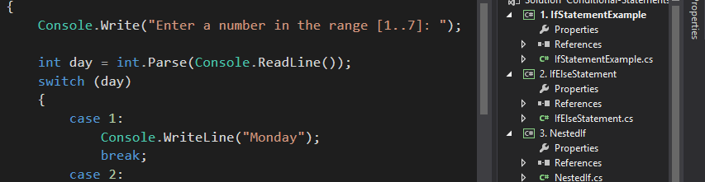
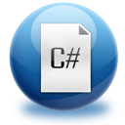
Programming Basics
Course Introduction
Programming
Basics
SoftUni Team
Technical Trainers
Software University
http://softuni.bg

Slide 2


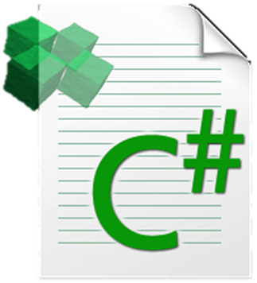
Table of Contents
Course Objectives
Course Program
Trainers Team
Examination
Learning Resources

Slide 3


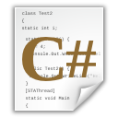
Programming Basics Course
Programming Basics
Course Objectives & Program

Slide 4
Course Objectives
The “Programming Basics" course:
First steps in computer programming with C#:
Compiler, IDE, variables, control-flow logic, console I/O, loops
Establish algorithmic thinking
Development of problems solving skills
Prepare for learning other languages and software technologies
Java, HTML, CSS, JavaScript, PHP
Databases & SQL, high-quality code
Web development technologies

Slide 5
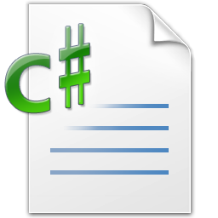
Programming Basics – Course Topics
Course Intro. Basic Mathematical Concepts for Programmers
Introduction to Programming. Using the IDE
Primitive Data Types, Variables, Literals
Console-Based Input and Output
Operators, Expressions and Statements
Conditional Statements (if-else, switch-case)

Slide 6
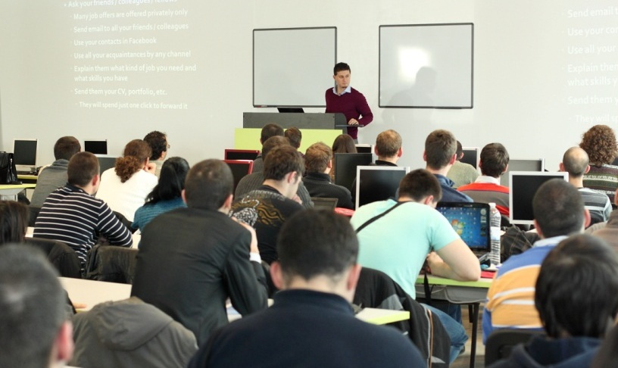
Programming Basics – Course Topics (2)
Loops (while, do-while, for, foreach)
Advanced Topics: Methods & Collections
Practical Lab on All Course Material
Exam Preparation: Solving Sample Exams
Practical Exam
Exam Review (Lab)

Slide 7

The Trainers Team

Slide 8
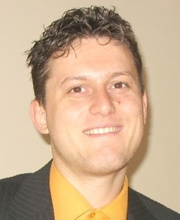
Trainers Team
Svetlin Nakov, PhD
Training & Inspiration Manager @ Software University
20+ years software development experience
10+ years experience as trainer
Author of 7 programming books
Speaker at hundreds of events
Web site & blog: www.nakov.com

Slide 9
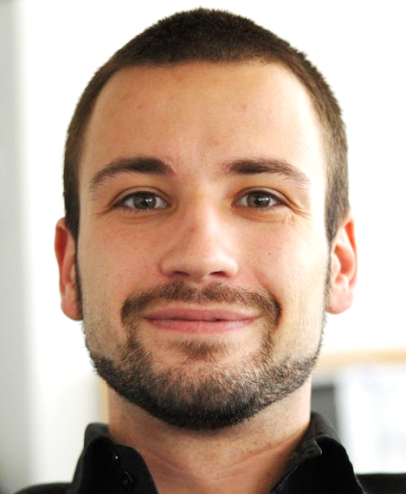
Trainers Team (2)
Angel Georgiev
Training Manager & Trainer @ Software University
Top performing student from the Software University (2014)
8+ years experience as Trainer in companies like Sony Ericsson, Samsung & Sony

Slide 10
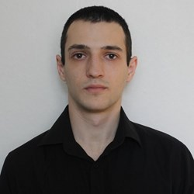

Trainers Team (3)
Vasil Indzhev
Top performing student from the Software University (2015)
Preslav Mihaylov
Top performing student from the Software University (2014)
Studies Computer Sciences in Varna Free University

Slide 11
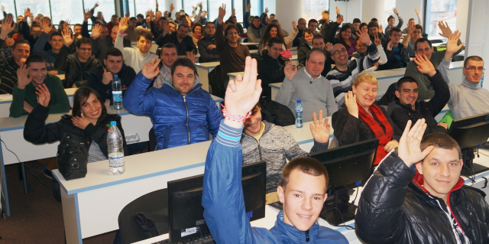
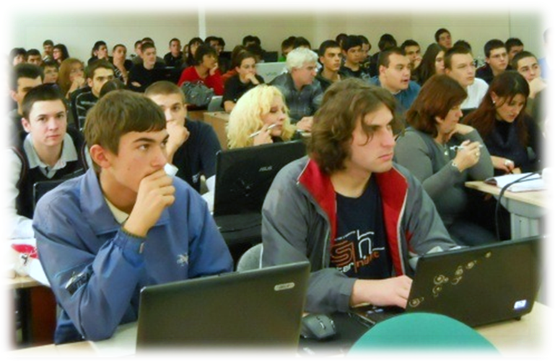
Volunteer Teaching Assistants
Volunteer teaching assistants
Top students from SoftUni (from the "Fundamentals" Module)
Top performers from previous "Programming Basics" courses

Slide 12
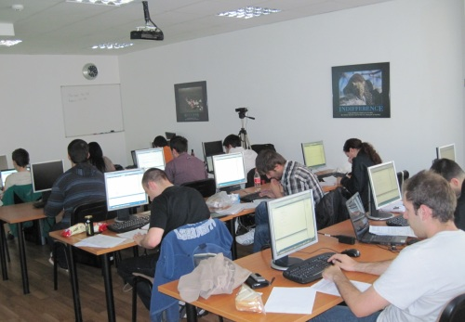

Programming Basics Course Details
Duration, Languages, Technologies

Slide 13

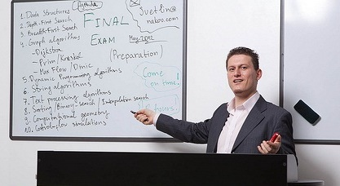
Training Duration – Programming Basics
Lectures: ~ 18 hours (onsite + YouTube videos)
Practical exercises (in class): ~ 18 hours
Homework + Lab + Exam Prep: ~ 50-100 hours
Exam: 6 hours
Allocation
Timeframe: December 2015 – February 2016
Exams: 21 February 2016

Slide 14
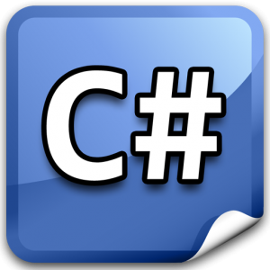


Why C# and .NET Framework?
C#, .NET and Visual Studio in Windows environment
Excellent start for beginners, very easy to learn
The C# language
Modern object-oriented language
Very popular, used by millions developers
Easy to learn, yet very powerful
C# is just the start!
We will learn Java, PHP, Linux, HTML, JS, SQL, and many more

Slide 15


Why English?
Why the slides are in English?
English is the native language of the software engineers
Specific terminology should be in English
Translations are inaccurate and funny
Just learn English!
No excuses

Slide 16

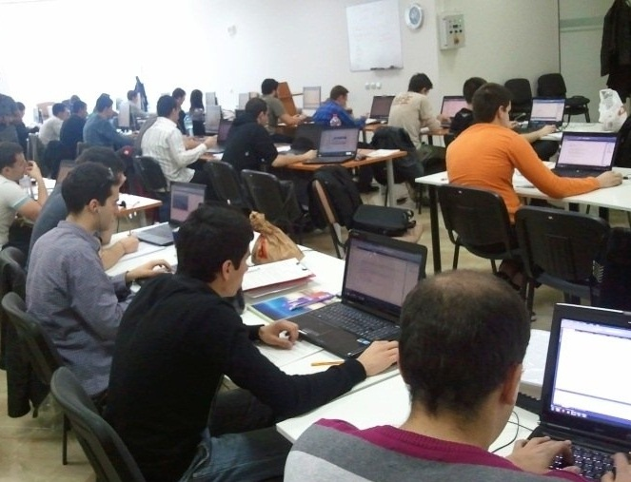
Programming Basics
Evaluation Criteria

Slide 17

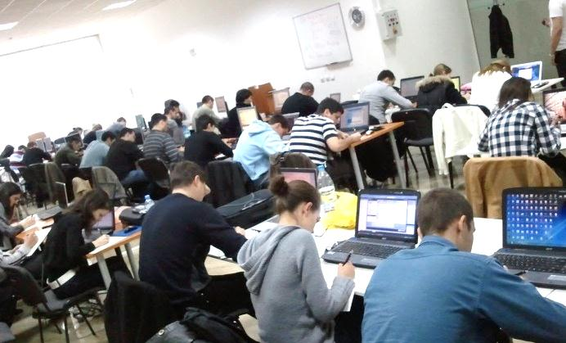
Exams @ Software University
Course score formed by several components:
Exam results, homework, forums activity, etc.
Exams measure the individual performance
Do you have basic coding skills?
The "Programming Basics" exam serves as admission criteria for the Software University
At least 100 points required for admission

Slide 18
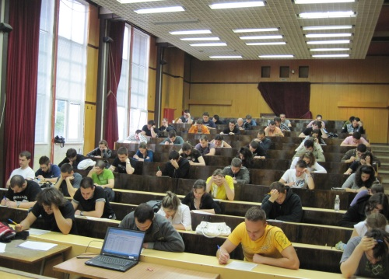

Programming Basics Exam
The practical programming exam explained
5 practical problems for 6 hours
1 very easy, 3 with loops, 1 with bit operations
Covers all learned topics up to the moment
Automated judge system & real-time feedback
Solutions are evaluated for correctness only
Code quality is still not measured

Slide 19
Programming Exam – Sample Problem
Write a program that enters a positive integer number N from the console (1 ≤ N ≤ 100) and prints a new year tree of size N, following the examples below:
N = 1
|
* | *
N = 2
|
* | *
** | **
N = 3
|
* | *
** | **
*** | ***
N = 4
|
* | *
** | **
*** | ***
**** | ****
N = 5
|
* | *
** | **
*** | ***
**** | ****
***** | *****

Slide 20
Programming Exam – Sample Solution
static void Main()
{
int n = int.Parse(Console.ReadLine());
for (int i = 0; i <= n; i++)
{
int asterisksCount = i;
string asterisks = new string('*', asterisksCount);
int spacesCount = n - asterisksCount;
string spaces = new string(' ', spacesCount);
Console.Write(spaces);
Console.Write(asterisks);
Console.Write(" | ");
Console.Write(asterisks);
Console.WriteLine(spaces);
}
}

Slide 21


Scoring System for the Course
Onsite students
Exam – 80%
Serves as pass / fail criteria
Homework + evaluation – 10% + 10%
Forums activity – bonus up to 10%
Online students
Exam – 100%
Forums activity – bonus up to 10%

Slide 22
Final Exam – What Comes Next?
exam score
0
100
400
500
485
Bank loan?
Fail
Pass
Average
Good
Champion
?
Try again at the next exam
Join the module "Fundamentals"
Apply for scholarship

Slide 23

Homework Assignments
Doing your homework is very important!
Programming can only be learned through a lot of practice!
You should write code every day!
Each lecture is followed by a few exercises
Try to solve them in class
The rest are your homework
Homework assignments are due in 6 days after each lecture
Submission will be accepted through our web site: softuni.bg

Slide 24

Homework Peer Reviews
Everyone will give feedback to a few random homework submissions
Students submit homework anonymously
Please exclude your name from the submissions!
For each homework submitted
Students evaluate 3 random pieces of homework
From the same topic, in 3 days after the deadline
Give written feedback, at least 200 characters
Low-quality feedback → report for punishment
Everyone can get feedback for their homework

Slide 25

The Judge System at the Exam
All exam problems will be tested automatically
Through our automated online judge system
During the exam preparation you will practice how to use the automated judge system
You can register at any time to practice
How the testing (judge) system works?
You submit your C# source code
Your solution is tested with predefined tests
For each test passed you get some score

Slide 26





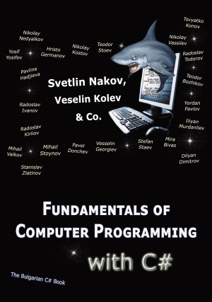



Resources
What We Need Additionally?

Slide 27

Course Web Site & Forums
The Programming Basics official web site:
Register for the "Software University Forum":
Discuss the course exercises with your colleagues
Find solutions for all course exercises
Share source code / discuss ideas / help each other
https://softuni.bg/courses/programming-basics/
http://softuni.bg/forum

Slide 28



The Programming Basics Slides and Videos
All lecture slides, videos, homework assignments, projects and other resources are open content, available for free
Visit the course web site to access the course resources

Slide 29

The Free C# Fundamentals Textbook
The official textbook for the course
"Fundamentals of Computer Programming with C#", by Svetlin Nakov & Co., 2013, ISBN 9789544007737
English and Bulgarian versions (as PDF, ePub, …)
Freely downloadable from: www.introprogramming.info
The C# Programming courses @ SoftUni.bg follow the book
Programming Basics → chapters 1..6 (up to Loops) + advanced topics

Slide 30
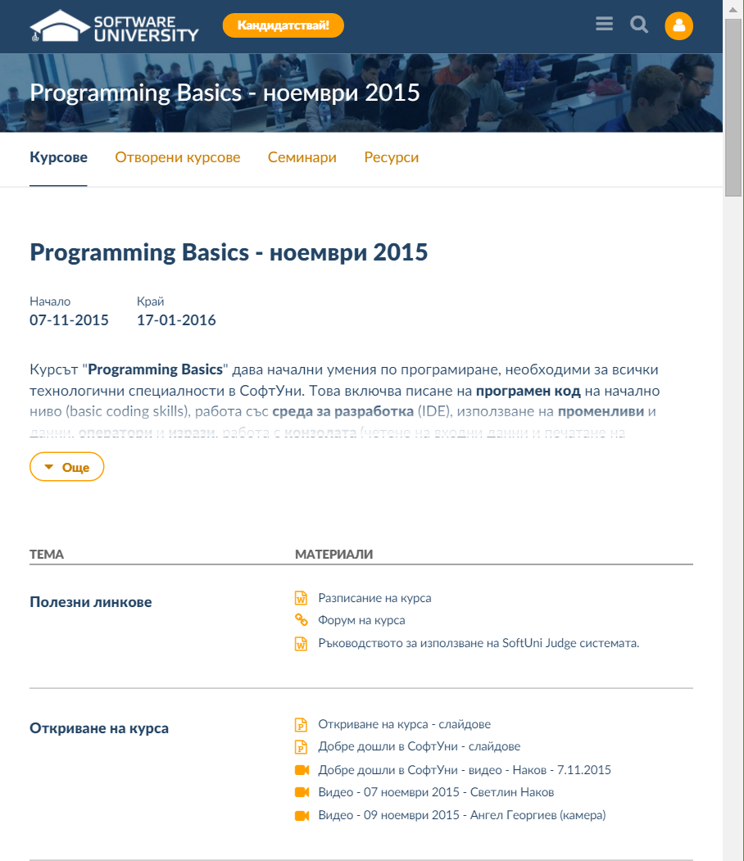
Software University Learning System (SULS)
Software University Learning System (SULS)
www.softuni.bg
Important resource for all students
Homework submissions
Homework check-up
Exams and results
Reports about your progress
…

Slide 31


Required Software
Software needed for this course:
Microsoft Windows (Win 8.1 / Win8 / Win7 / Win XP)
Visual Studio Community 2013 (a free version of VS 2013)
Visual Studio 2012, 2010, 2008 acceptable, but not recommended
.NET Framework 4.5 (included in Visual Studio)

Slide 32
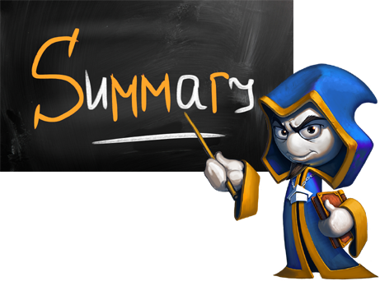
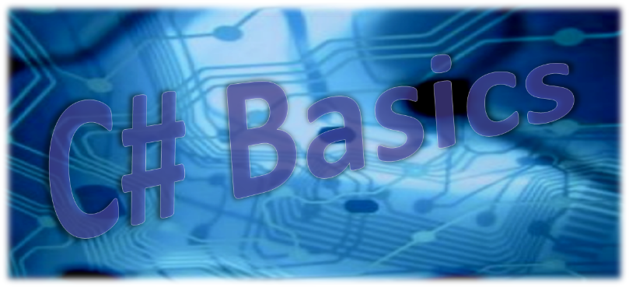
Summary
The “Programming Basics" course provides
The very first steps in programming
Training program
Programming, using Visual Studio, variables, control-flow logic, loops, advanced topics
Practical exams
Automated judge system + score system
Learning resources
Lectures, videos, software, books, forum

Slide 33








Programming Basics – Course Introduction
httpshttps://softuni.bg/courses/programming-basics/

Slide 34
License
This course (slides, examples, demos, videos, homework, etc.) is licensed under the "Creative Commons Attribution-NonCommercial-ShareAlike 4.0 International" license
Attribution: this work may contain portions from
"Fundamentals of Computer Programming with C#" book by Svetlin Nakov & Co. under CC-BY-SA license
"C# Part I" course by Telerik Academy under CC-BY-NC-SA license

Slide 35






Free Trainings @ Software University
Software University Foundation – softuni.org
Software University – High-Quality Education, Profession and Job for Software Developers
softuni.bg
Software University @ Facebook
facebook.com/SoftwareUniversity
Software University @ YouTube
youtube.com/SoftwareUniversity
Software University Forums – forum.softuni.bg

